Slide 1
A number line is a graph that contains both integers and rational numbers
Can you identify the integers and rational numbers on this graph?
Can you identify the opposites of each rational number and
the opposites of each integer?
How can you prove that a number is the opposite of another?
What happens when we add two opposites?

Slide 2
Vocabulary check
How can we define the additive inverse property?
What number is the additive identity and why?
The additive inverse of x is another number, y, as long as the sum of x + y equals zero.
The additive identity is another number that when added to y, does not change the value of y
The sum is the value of combining two or more numbers using addition.
The difference is the value after combining two or more numbers using subtraction.

Slide 3
Let’s discuss…
How could we represent this scenario using a number line?

Slide 4

More to discuss…
Are these two equations equivalent? Why or why not?
$$\left|x\right|$$
Do you recognize this?
What do you notice about the sum when a negative is added?

Slide 5
Vocabulary Check
$\left|x\right|$ This is the symbol used for absolute value. What words can we use to define
the absolute value?
I understand p + q as the number located a distance |q| from p, in the
positive or negative direction depending on whether q is positive or negative.
Make sense of the learning target.

Slide 6
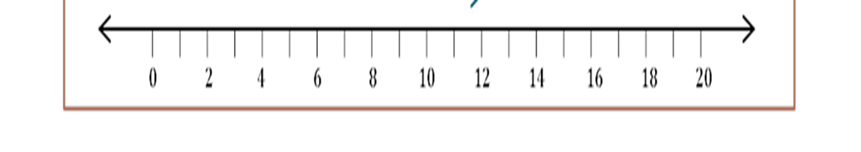
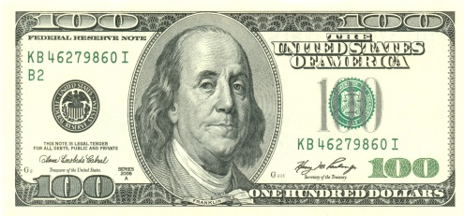


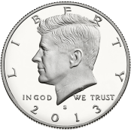
How can we accurately graph decimals on the number line?
Where would we graph the decimal 1.9?
Where would we graph the decimal 0.9?
What are the benchmark decimals?
What’s money got to do with it???
Do Decimals have opposites?

Slide 7
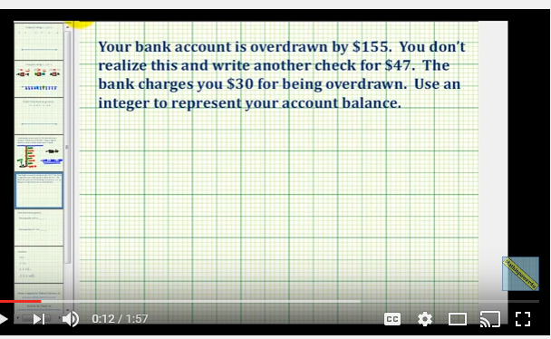
Let’s watch a video
https://youtube/rywucgsvDjU

Slide 8
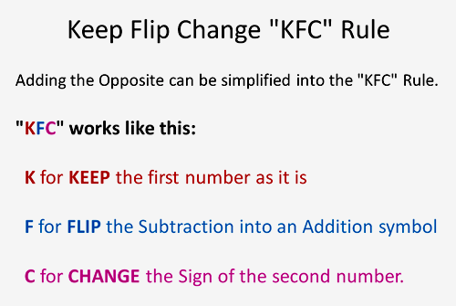
Making General rules

Slide 9
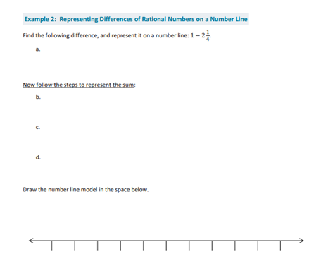
Can we develop a general rule for subtraction?
What steps do we already know and can EXPLAIN?
What does the mathematics statement (sentence) look like?

Slide 10
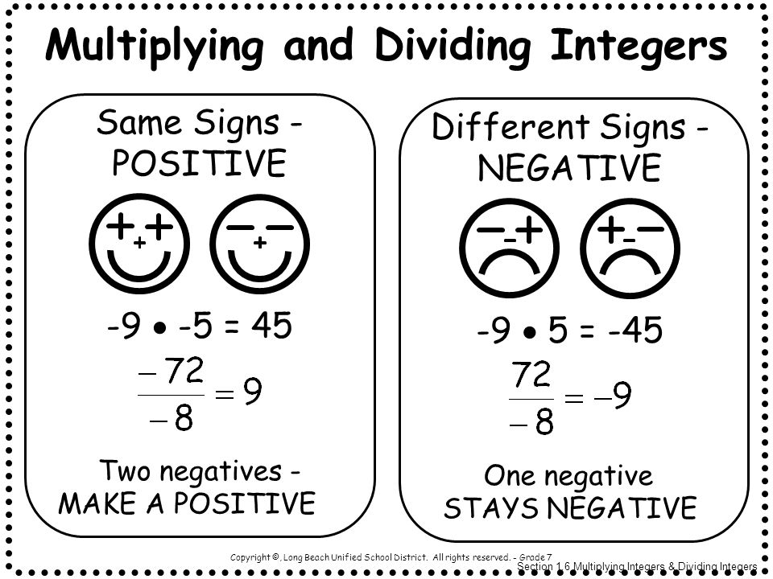
Multiplying & Dividing Integers
In multiplication and division, however, you calculate the result as if there were no minus signs and then look at the signs to determine whether your result is positive or negative.
Just do the math!!

Slide 11
Example 1: Multiplying and Dividing Integers
Multiply or Divide.
  6(-7)
    -42
  -45 / 9
    -5
  -12 (-4)
    48
  18 / -6
    -3
Try these on your own…
  -6(4)
    -24
  -8(-5)
    40
  -18/2
    -9
  -25/-5
    5

