Slide 1
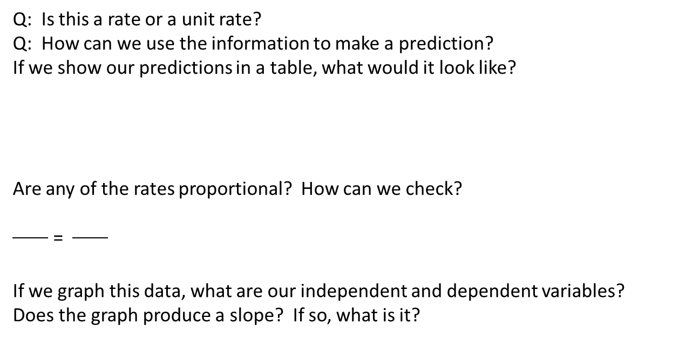
EXAMPLE #1
Gasoline costs $4.24 per gallon.
Q: Is this a rate or a unit rate?
Q: How can we use the information to make a prediction?
If we show our predictions in a table, what would it look like?
Are any of the rates proportional? How can we check?
=
If we graph this data, what are our independent and dependent variables?
Does the graph produce a slope? If so, what is it?
Cost
Gallons

Slide 2
Break out and Collaborate!
Work in a small group of no more than 3
Example 2: Five Gala apples cost $2.00.
Create a table relating the number of apples to their cost.
Create a graph and report the slope.

Slide 3
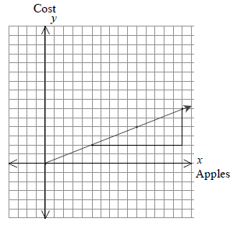
Using the slope triangle, we see that the slope is rise /run = 4 /10 = 2 /5 . Therefore the equation of this relationship is y = 2 /5 x . The slope is also the unit rate or constant rate of change: for every five apples, we pay another $2.00. To see this as a unit rate, we need to know the cost of one apple. If five apples cost $2.00, then one apple costs 2.00 5 = 0.40 , or $0.40 for each apple. This is also represented on the graph: for each apple, the graph rises only 0.40.

Slide 4
EXIT TICKET: Work Independently
Example 3: Bike riding
Create a table relating the amount of time to distance traveled
Create a graph and report the slope.

Slide 5
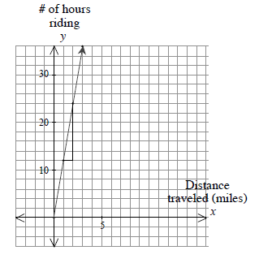
We are relating the number of hours Tess rides her bike to the distance she has traveled. This is a proportional relationship: it passes through the origin, and if the number of hours is doubled or tripled, the distance Tess travels is also doubled or tripled. Here, the equation representing this data is y = 12x where x is the number of hours of riding, and y is the number of miles she has traveled. The graph at right contains a slope triangle. The slope, or unit change, is rise run = 12 /1 or simply 12.

Slide 6
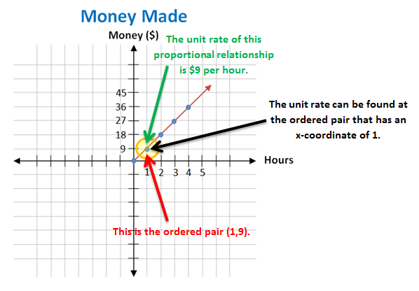
Putting it all together:

