Slide 1
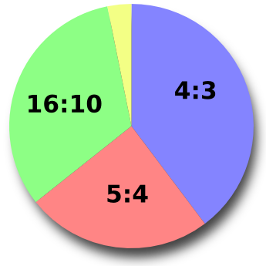
Exit Ticket #2
Are angles, fractions, decimals, and ratios related? If so, how?
Directions:
Write a Summary of understanding to display how these terms are connected.
Label the picture with each of the terms that you believe are present in the picture.

