Slide 1
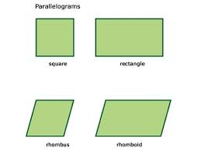
Exit ticket #4
Print your response to each of the questions AND draw a picture that represents you answer for each question.
1. Is a parallelogram a square and a rectangle? Why or why not?
2. Is a rectangle and a square a parallelogram? Why or why not?
3. Is a rectangle a square? Why or why not?

