Slide 1

Geometry
1st 7 weeks of math academics will be the study of geometry

Slide 2

Vocabulary
Copy each of the vocabulary terms.
Geometry
Angle
Arc
Decompose
Composition
Bench mark degrees of Geometric measure
Point
Line
Plane
Coplanar
Collinear
Postulate
Theorem
End point
Line segment
Ray
Midpoint

Slide 3
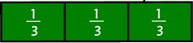
Week 1
Question
What does an angle have to do with a fraction?
Think about the question and then discuss the question with someone at your table.

Slide 4



Your Geometric point
What is your point?
Mentally- where you stand on an issue
Your GPS- your position on the Globe.
Physically- where your feet are planted on the earth.
Your geometric point is determined by your positon on the x, y axis simultaneously!!

Slide 5
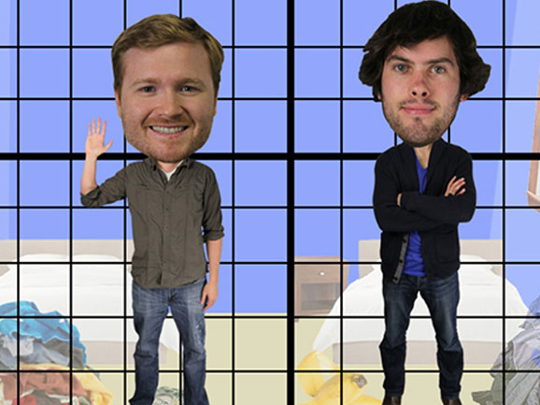
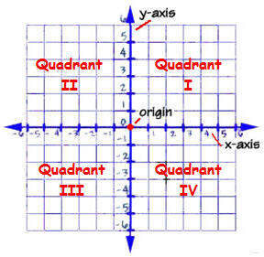
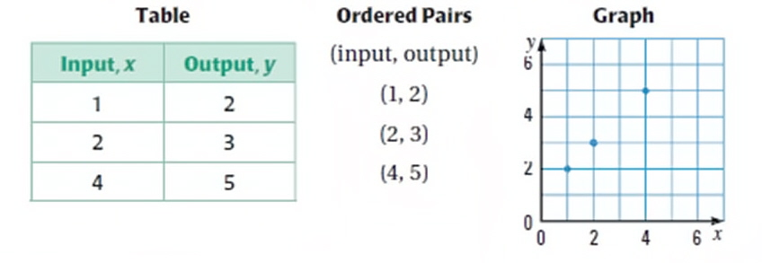

Slide 6
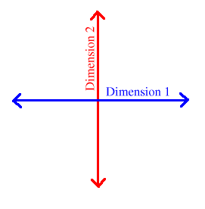
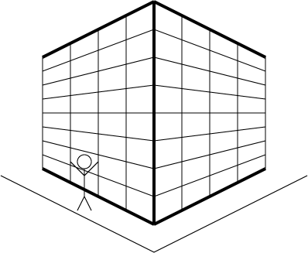
What does this have to do with geometry?
Geo- the earth
Metry- measurement
The science of geometry gives “point” to everyone and everything.
The basics: point, line, line- segment, endpoint, ray…
3 D

Slide 7
Put it together
Many points in a plane make a line.
Line extend in two directions infinitely.
RAY

Slide 8
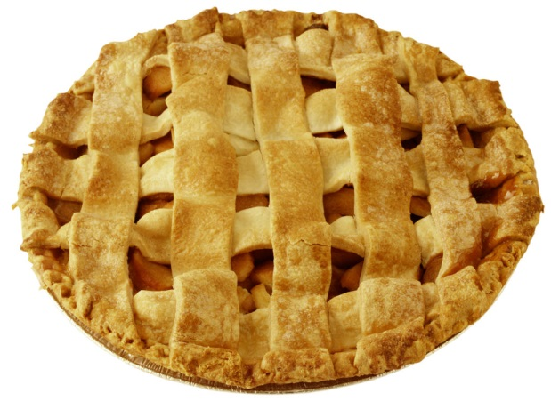
How does this help to answer the question???
Who can eat a whole pie?
Do you see your vocabulary here?
A slice is a nice part of the pie to eat
Who can talk about it?

Slide 9

Let’s Explore
Draw your understanding….
Make a circle
Find the center of your circle and make a point.
Turn your point into an endpoint by drawing a ray from it.
Turn your ray into an angle
Make both ends of your angle intercept the circle.
Tools:
Paper
Pencil
Protractors
Pie pieces
Colored pencils

Slide 10
Just for entertainment…
Make a poster of your understanding…
https://www.youtube.com/watch?v=OmSbdvzbOzY

