Slide 1
Welcome Back!! Do #1!!
1. A seventh grader’s birthday is today, and she is 12 years old. How old was she 3$\frac{1}{2}$years ago? Write an equation, and use a number line to model your answer.

Slide 2
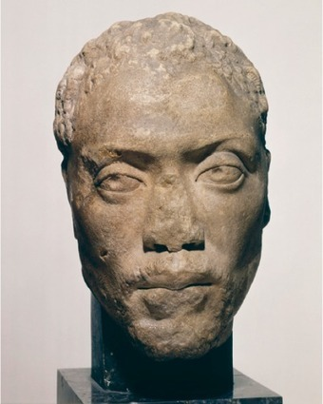
Thought Experiment
Imagine that you are a philosopher from back in the day…
You are not sure of how to answer your student’s question about the PRODUCT of two number that are the same sign or opposite signs, how could you show your student what the Product will be?
For example: 5 X -3= ? -2X-6=?
Good Mathematicians always use math proofs to verify their work:
Additive property of addition
The Zero property of multiplication
The commutative property (of multiplication and addition)
Can the number line be used?

Slide 3
Properties of operation
Associative property(+&X)
Commutative property (+&X)
Additive property
Additive inverse property
Multiplicative identity property
Multiplicative inverse
Grouping
Moving
Adding 0
Adding opposite=0
Multiply by #1.
What do I multiply by to get

Slide 4
The commutative property of multiplication states that when finding a product, changing the order of the factors will not change their product. In symbols, the commutative property of multiplication says that for numbers a and b:
^{a⋅b = b⋅a}
The associative property of multiplication states that when finding a product, changing the way factors are grouped will not change their product. In symbols, the associative property of multiplication says that for numbers a,b and c:
^{(a⋅b)⋅c=a⋅(b⋅c)}

Slide 5
What vocabulary do you see?
Could we simplify before operating?
How does the commutative property help us here?
Think of GCF
Let’s try another…

Slide 6
What property can we use here? What gives you the hint?
What property can we use here and how will we evaluate?

Slide 7
Mastery Group work
Use the properties to help write an equation that can be used to solve a real life scenario:

Slide 8
Explanation

Slide 9
Module 7, Lesson 15-s.78 Homework review..
Let’s Try one more…

