Slide 1
RIGHT TRIANGLES
PYTHAGORAS EXPLAINS THEIR RELATIONSHIP!!

Slide 2
IF
IF you are using a right triangle…
Then A²+ B² = C²
This means that if we know the length of at least two side, I can always find the length of the third side.

Slide 3
2 LEGS AND A HYPOTENUSE
Hypotenuse- the side opposite the right angle. It is also the diagonal distance across a square!!
a
c
b

Slide 4
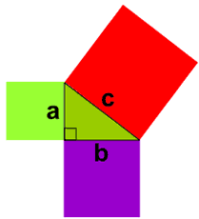
Draw Squares on the Triangle
Basically, if you construct a square from each side of your triangle. You will make three squares.
Who remembers the formula for area of a square?
Yep its A²… for any
square

Slide 5
The big square
Pythagoras agree with what the EGYPTIANS had already told the WORLD!!
The sum of the areas for the two small squares is = to the area of the big square.
http://www.mathsisfun.com/pythagoras.html

Slide 6
Finding the length of ANY side
Because Squares are polygons, their sides are straight lines.
The lines can be measured to find the length.
If we are using a right triangle and a side is missing, we can find it!
We can also find the distance between two objects.

